Slide 1

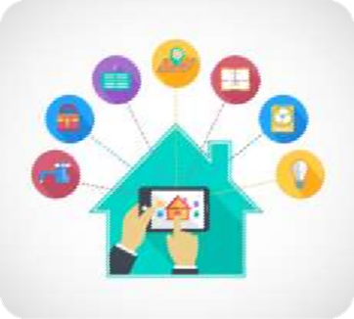
Home Automation
By Jude Praveen Raj J

Slide 2
Introduction
Nowadays, we have remote controls for our television sets and other electronic systems, which have made our lives real easy. Have you ever wondered about home automation which would give the facility of controlling tube lights, fans and other electrical appliances at home using a remote control? Off-course, Yes! But, are the available options cost-effective? If the answer is No, we have found a solution to it. We have come up with a new system called Raspberry pi 3 based home automation using Wi-Fi. This system is super-cost effective and can give the user, the ability to control any electronic device without even spending for a remote control. This project helps the user to control all the electronic devices using his/her smartphone.
Time is a very valuable thing. Everybody wants to save time as much as they can. New technologies are being introduced to save our time. To save people’s time we are introducing Home Automation system using Wi-Fi . With the help of this system you can control your home appliances from your mobile phone. You can turn on/off your home appliances within the range of Wi-Fi.

Slide 3
Project Aim
The aim of the project is to design and construct a home automation system that will remotely switch on or off any household appliances connected to it, using a microcontroller , voice dial on phone , or Wi-Fi based application.
Project Objective
The objective of this project is to implement a low cost , reliable and scalable home automation system that can be used to remotely switch on or off any household appliance , using a microcontroller to achieve hardware simplicity, low cost short messaging service for feedback and voice dial from any phone to toggle the switch state.
Project scope and limitation
This project work is complete on its own in remotely and automatically switching on or off of an electrical appliance not limited to household appliances and sends a feedback message indicating the new present state of the appliance.

Slide 4
Hardware Requirement
The list of components mentioned here are specifically for the Home automation to be possible
Raspberry Pi 3 with Broadcom microcontroller
Node MCU Wi-Fi Module
5 V Relay X 8
Connecting wires
9 V Power supply
Led Lights
Computer Monitor 19’
USB Mic
Speaker
SD Card 8GB
Jumper wires
Software Requirement
Raspbian Jessie
Arduino IDE
Alexa API
Weather API
Times NEWS API
Clock API
Calendar API
Node JS

Slide 5
Description of Hardware Required
Raspberry Pi 3
The Raspberry Pi 3 is a microcontroller board based on the Broadcom. It has 40 digital input/output pins (of which 6 can be used as PWM outputs), 6 analog inputs, a 16 MHz crystal oscillator, a USB connection, a power jack, an ICSP header, and a reset button. It contains everything needed to support the microcontroller; simply connect it to a computer with a USB cable or power it with a AC-to-DC adapter or battery to get started.
The Raspberry Pi 3 differs from all preceding boards in that it does not use the FTDI USB-to- serial driver chip. Instead, it features the Broadcom programmed as a USB-to- serial converter.

Slide 6
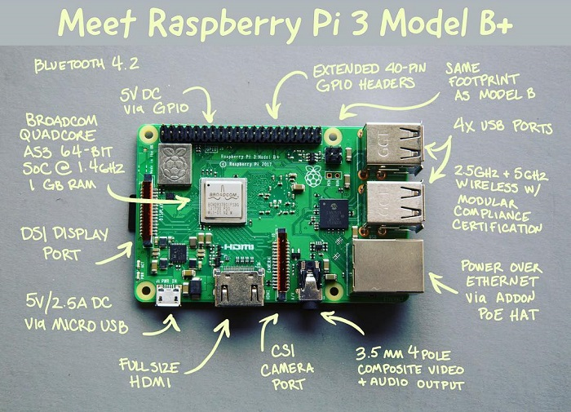
Raspberry Pi 3 Micro controller

Slide 7

Smart Mirror
It all relies on the use of a regular picture frame, and mirrored window film to turn the glass into a two way mirror.
The Mirror also includes a bonus Alexa installation. Your smart mirror will be great without this, but it's nice to have a voice assistant in your mirror to ask tough questions or control home automation.
curl -sL https://deb.nodesource.com/setup_4.x — Node.js v4 LTS "Argon" | sudo bash -
sudo apt-get install nodejs sudo

Slide 8
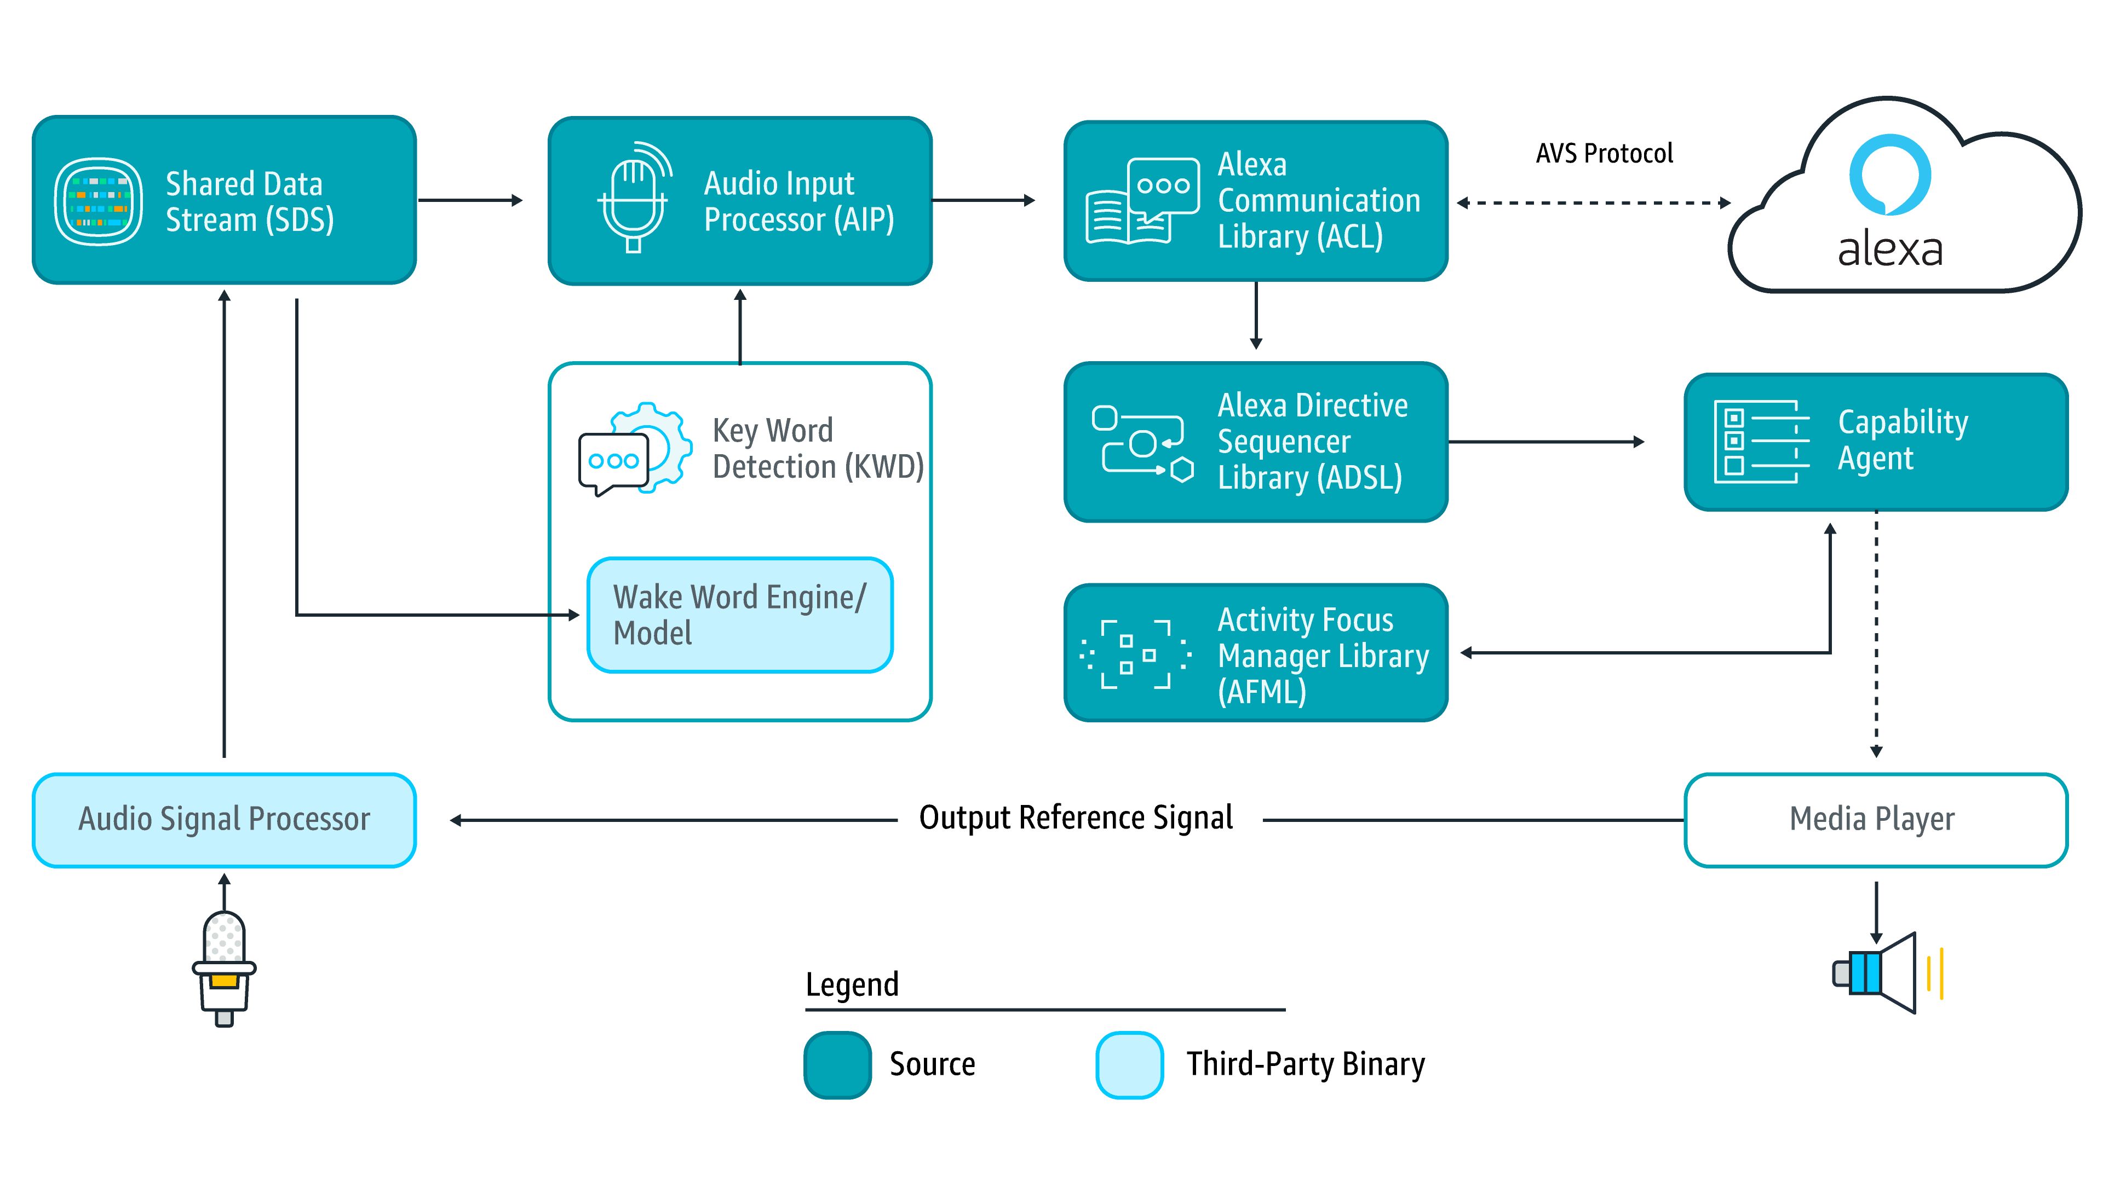
Alexa
How is it Possible for Alexa to have a conversation with us:

Slide 9
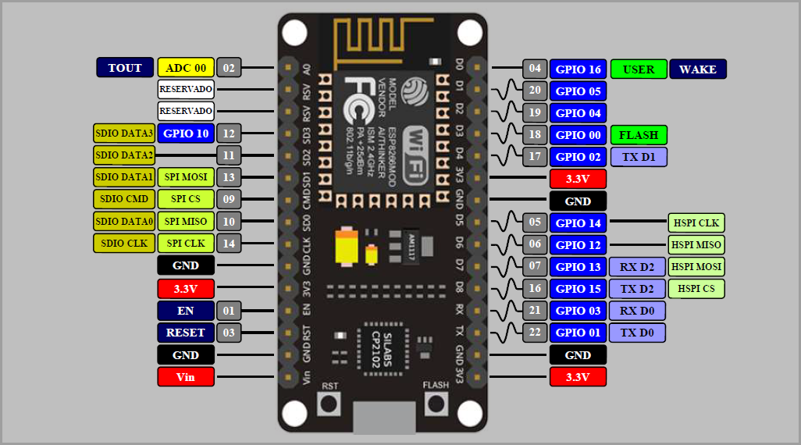
Node MCU Wi-Fi Module
Node MCU module is an easy to use Wi-Fi SPP (Serial Port Protocol) module, designed for transparent wireless serial connection setup.
Serial port Wi-Fi module is fully qualified Wi-Fi V2.0+EDR (Enhanced Data Rate) 3Mbps Modulation with complete 2.4GHz radio transceiver and baseband.

Slide 10
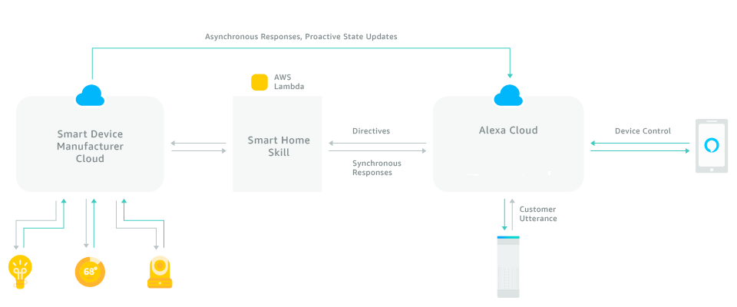
Smart Home Skills API
Alexa recognizes the customer intent to change a setting on a specific device. Like…
Alexa, turn on device
Alexa, turn off device
Alexa, defrost three pounds of meat in my microwave

Slide 11

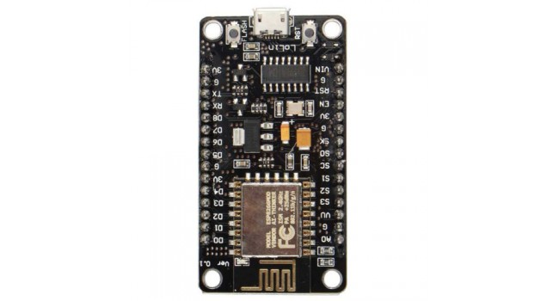
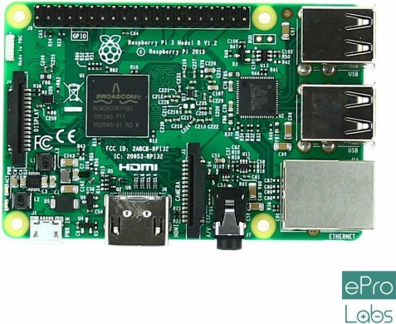
Node MCU Wi-Fi Module Interfacing with Raspberry Pi 3
Node MCU is a Wi-Fi device used for wireless communication with Wi-Fi enabled devices (like smartphone), where Router acts as an interface between the Raspberry pi and Node MCU.
Router

Slide 12
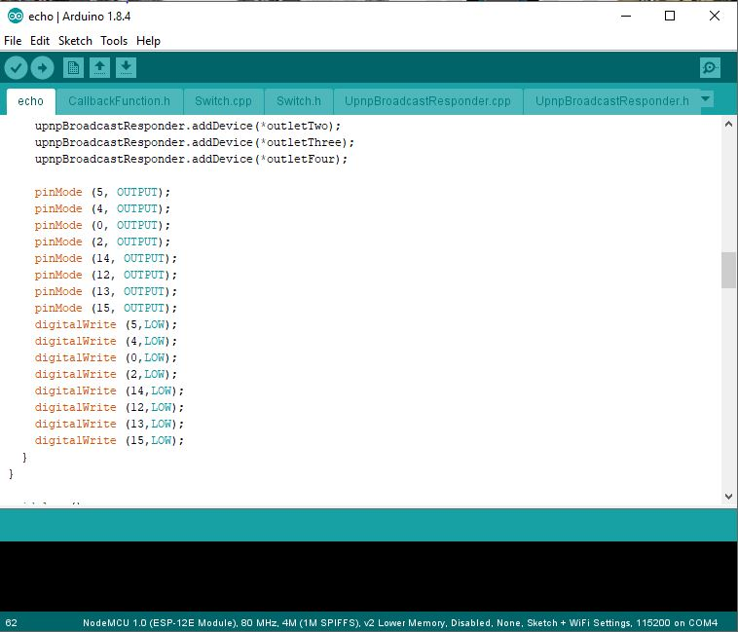
Program Code

Slide 13
Pros of Home Automation
Security
Tap your finger to turn on the lights when you get home so you aren’t worried about what’s hiding in the shadows, or in your pathways. Or automate to turn on when you aren’t home to look like you are to ward off potential robbers. Door locks are another automated home product that can increase your home security.
Energy Efficiency
Increase your home’s energy efficiency by remotely powering off systems and appliances when they aren’t in use. In addition to the standard home automation products that give you active control, some products actively monitor systems and arm the homeowner with knowledge, insight and guidance to achieve greater control and energy efficiency.
Savings
Home automation literally pays off. When you are able to use home systems and appliances only when needed, the savings will be apparent in the first utility bill. No more wasting money on lights left on when you aren’t home, or spending money on gas to drive home because you forgot to lock the door. Monetary savings are apparent, but you’ll also be saving time. No wasted trips home, no running through the house turning everything off, no time spent worrying about what was or wasn’t turned off.
Convenience
Don’t you hate having to rely on neighbors to watch your house when you’re gone? With home automation, convenient control of your home is at your fingertips. You don’t have to trust someone else with your most valued possessions.
Comfort
Ever leave for work in the morning when it was a comfortable 68° outside only to come home to a sweltering house because the temperature shot up to 90°? Connected home products like the Sensi™ Wi-Fi Thermostats let you conveniently adjust your home temperature from the mobile app so your family is always comfortable.

Slide 14
Cons of Home Automation
1. Cost of Intelligence
Installing state-of-the-art features inside a home results in a higher price tag for the property. The cost of an intelligent home that makes our lives convenient is high because some of the technology is relatively new. The cost of living expenses such as utilities, maintenance and repair of the technology can be expensive as well.
2. Technology Learning Curve
Owning a smart home means having to learn how to use your home. Unlike traditional homes, smart home technology requires you to adapt to the innovations within your living area such as security systems, air units and a remote that controls your entire house. For the technology-savvy family, the smart home will help achieve convenience faster, but for others, it will take reading manuals and learning how-to before the benefits of convenience pay off.
3. Video Surveillance
Video surveillance can be a wonderful tool in heightening security and deterring crime, but when the technology falls into the wrong hands, issues of privacy can occur. Security sensors within the doors and walls of a smart home use wireless technology to transfer signals to a central control unit that
notifies emergency officials of any foreign activity.

Slide 15
Applications
Using this project, we can turn on or off appliances remotely.
The project can be further expanded to a smart home automation system by including some sensors like light sensors, temperature sensors, safety sensors etc. and automatically adjust different parameters like room lighting, air conditioning (room temperature), door locks etc. and transmit the information to our phone.
Additionally, we can connect to internet and control the home from remote location over internet and also monitor the safety.
Future Development of the project
Smart Mirror can be embedded with face detection which can detect human reactions, gestures as well as objects.
Raspberry Pi 3 based device control using Wi-Fi on Smartphone project can be enhanced to control the speed of the fan etc.
We can replace Wi-Fi by GSM modem so that we can achieve device controlling by sending SMS using GSM modem.

Slide 16
Conclusion
The home automation system has been experimentally proven to work satisfactorily by connecting sample appliances to it and the appliances were successfully controlled from Alexa.
The Wi-Fi Module was successfully tested on a multitude of different electronic devices thus proving its portability and wide compatibility. Thus a low-cost home automation system was successfully designed, implemented and tested.

